Slide 1
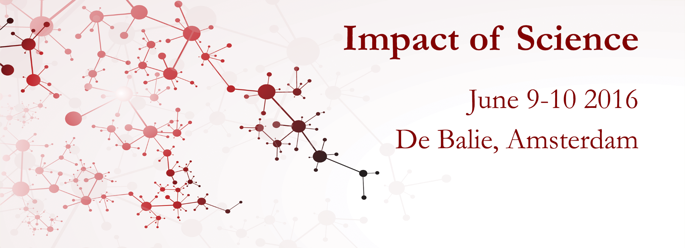

Welcome to the Interactive Course on
Assessing Impact of Science:
Methods & Instruments
3-5 November, 2021

Slide 2


Assessing Impact of Science:
Methods & Instruments
3-5 November, 2021
DAY 1
#AISMI21
@AesisNet

Slide 3
Assessing Impact of Science:
Methods & Instruments
3-5 November, 2021
Jonathan Grant
Founding Director, Different Angles Ltd
#aismi21

Slide 4

Communicating your impact
Jonathan Grant
Different Angles Ltd
jgrant@differentangles.co.uk
@jonathancgrant

Slide 5





Take home messages
An undervalued element of research impact assessment is communications
Audiences are diverse, often requiring different and concurrent approaches to communicating impact
The ‘pyramid principle’ is a good approach for communicating impact to policy and decision makers
It is not rocket science, but you do need to think about communications and design that into impact and impact assessment
There is no point having an amazing impact if you can talk about it!

Slide 6




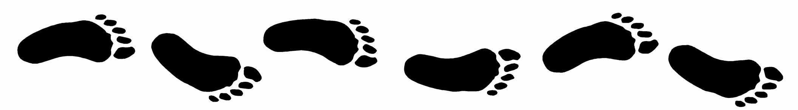

My impact story
Impact
(inc the assessment of research)
Resulted in an interest in ‘telling stories’ (and how)
(Research)
policy
Social movements
(and social purpose)

Slide 7
Impact by design ... The 7Cs
https://emeraldopenresearch.com/articles/1-18/v1

Slide 8
Some questions to get going
Can we do a poll
Tonight is a Friday, are you going to go dancing all night (1) or get a good book and read that in front of the fire (6)?
You are going on holiday in 4 weeks time, do you buy a guidebook and plan what you are going to do and when (1) or are you more spontaneous, lasminitue.com (6)?
Would you rather write a romantic novel (1) or a popular science book (6)?
When you decided to sign up to this course did you think hard about the pros and cons of participating (1) or did you just decide to give it a go (6)?

Slide 9
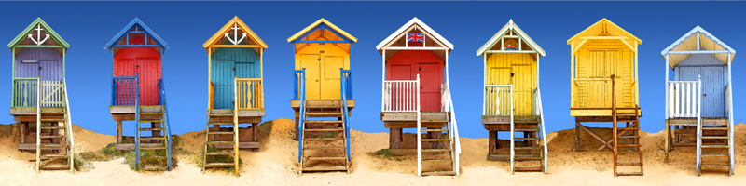

Slide 10
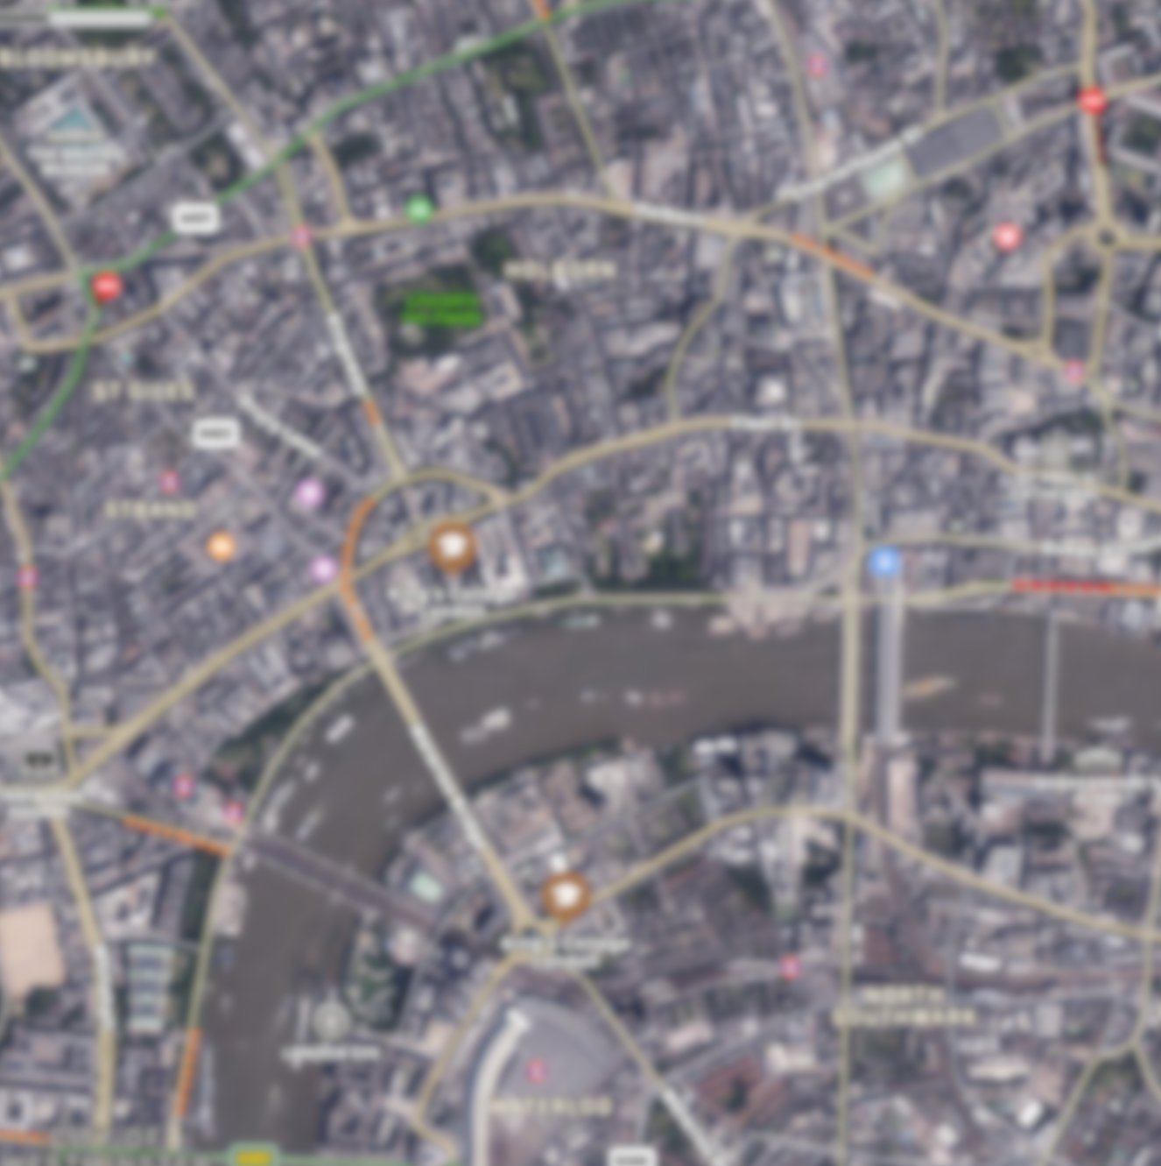
Notes:
BW

Slide 12
Logical / rational
Big picture
Detail

Slide 13
Logical / rational
Emotional
Big picture
Detail

Slide 14
Different preferences, require different communication tools
Logical / rational
Emotional
Big picture
Detail

Slide 15
Different preferences, require different communication tools
Logical / rational
Emotional
Big picture
Impact mapping
Detail

Slide 16
Different preferences, require different communication tools
Logical / rational
Emotional
Public narrative
Big picture
Impact mapping
Detail

Slide 17
Different preferences, require different communication tools
Logical / rational
Emotional
Public narrative
Pyramid principle
Big picture
Impact mapping
Detail

Slide 18
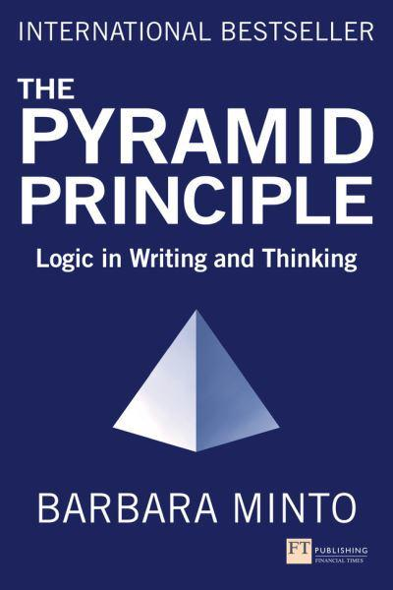
Getting to the right question
Structuring your ideas

Slide 19
Exercise: Organise these words
snake
bath
Group these words into
two sets of four words
(and have clear reasons for why you have grouped them that way)
gym
dance
soldier
soup
crane
bridge
Notes:
ALEX

Slide 20
Getting to the right question
+
=
Situation
Complication
Question
Diabetes is one of the world’s biggest health challenges with prevalence rates increasing globally and the costs of diabetes-related treatment accounting for a significant proportion of healthcare budgets.
Bariatric surgery is a proven, cost-effective approach to reducing the impact of diabetes amongst those patients showing most risk of the disease BUT is not being widely adopted.
Why is bariatric surgery not being used more widely in the treatment of diabetes?

Slide 21
A research narrative: ‘Jesus was married’
“On 18 September 2012 a newly-discovered Coptic gospel fragment, purportedly dating from the 4th century, was announced in Rome. It generated worldwide publicity: for in it, Jesus refers to ‘my wife'.
Three days later, Professor Francis Watson posted a short paper online, in which he used a form of compositional analysis which he has pioneered to argue that the fragment is most probably a recent forgery.
Watson's paper was extensively read and reported, and widely regarded as conclusive. An imminent TV documentary on the fragment was promptly postponed indefinitely.
Watson's research transformed the way that this fragment was perceived by an international public. As such, it prevented a serious scholarly error from becoming lodged in the public consciousness.
It is an example of the power of a timely web-enabled intervention by a scholar in a fast-moving news story.”
‘The Case of the Forged Gospel Fragment’, REF 2014 IMPACT CASE STUDY
http://impact.ref.ac.uk/CaseStudies/CaseStudy.aspx?Id=11837

Slide 22
Let’s try together …
Situation
Complication
Question
=
+
Question
or
Question
or

Slide 23

Now your turn …
Situation
Complication
Question
=
+
Question
or
Question
or

Slide 24
Finding the right question
Other track question
Broader question
Initial question
Narrower question
Other track question
Other track question (narrower)

Slide 25
Finding the right question
How can we stop pollution at source?
How can we stop pollution?
How can we stop pollution entering the sea?
How can we stop farm pollution entering the sea?
How can we clean up seawater?
How can we clean up plastics in the sea?

Slide 26
Getting to the right question
Structuring your ideas

Slide 27
Situation + Complication = Question
Answer
Arguments/ideas
Detail/evidence/actions
[more detail/evidence/actions]

Slide 28
Building the ideas ‘bottom up’
Question
Summary answer
Group and abstract
Key idea
Key idea
Key idea
Group and abstract
Detail
Detail
Detail
Detail
Detail
Detail
Detail
Detail
Detail

Slide 29
Expanding the ideas ‘top down’
Question
Summary answer
What, why and when
Key idea
Key idea
Key idea
What, why and when
Detail
Detail
Detail
Detail
Detail
Detail
Detail
Detail
Detail

Slide 30
Use the boxes to construct a thought pyramid…
Fish
It is uncrowded
Unique ice formations
The North Pole is an
attractive holiday destination
Wild, snowy, dune-like
There are opportunities for spotting wildlife
Population under 1 per 1000 km²
Arctic terns
In most terrain, no human foot has ever trod
The landscape is stunning
Polar bears

Slide 31
The North Pole is an
attractive holiday destination
There are opportunities for spotting wildlife
It is uncrowded
The landscape is stunning
Population under 1 per 1000 km²
In most terrain, no human foot has ever trod
Wild, snowy, dune-like
Unique ice formations
Arctic terns
Fish
Polar bears

Slide 32
The North Pole is an
attractive holiday destination
Why?
There are opportunities for spotting wildlife
It is uncrowded
The landscape is stunning
What?
How?
Why?
Population under 1 per 1000 km²
In most terrain, no human foot has ever trod
Wild, snowy, dune-like
Unique ice formations
Arctic terns
Fish
Polar bears

Slide 33
The North Pole is an
attractive holiday destination
So?
There are opportunities for spotting wildlife
It is uncrowded
The landscape is stunning
So?
So?
So?
Population under 1 per 1000 km²
In most terrain, no human foot has ever trod
Wild, snowy, dune-like
Unique ice formations
Arctic terns
Fish
Polar bears

Slide 34
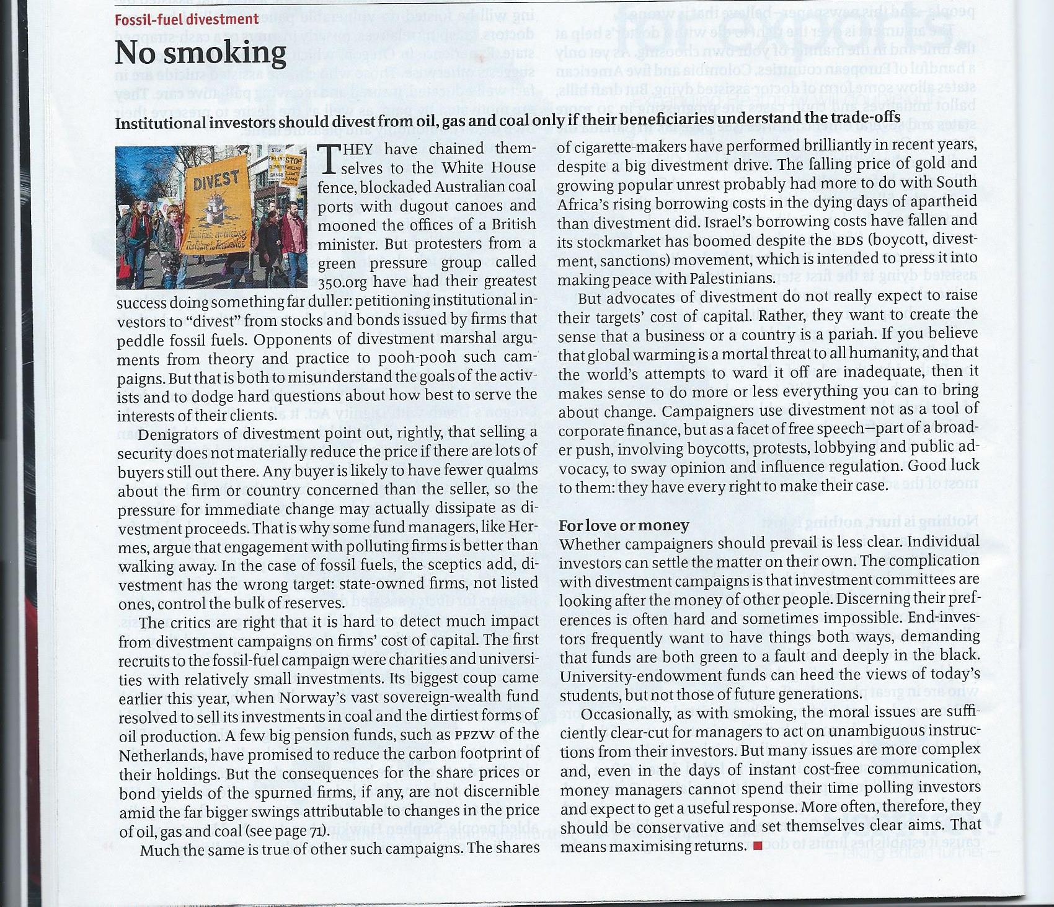

Slide 35
Answer
2nd key idea
Detail 2.1
1st key idea
Detail 2.2
Detail 1.1
Detail 1.2
Detail 1.3

Slide 36
Institutional investors should diverse from fossil fuels if people understand the trade offs
Selling shares does not reduce price if there are a lot of buyers
Advocates of divestment are not interested in share prices
No impact on share prices
It is a moral argument – global warming threatens humanity
Some pension funds have tried
Divestments debate is a vehicle for protest and raising the issue
No real impact

Slide 37
Now your turn …
Situation
+
Complication
=
Question
Summary Answer
Key line argument 1
Key line argument 2
Key line argument 3
Key line argument 1.2
Key line argument 2.1
Key line argument 3.1
Key line argument 1.2
Key line argument 2.2
Key line argument 3.2
Key line argument 1.3
Key line argument 2.3
Key line argument 3.3

Slide 38
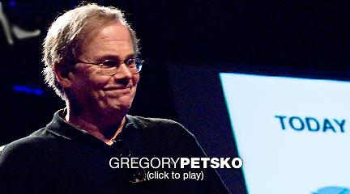
What tools does Gregory use to get his message across?
https://www.youtube.com/watch?v=XSb-pIloOFc

Slide 39
Gregory Petsko’s thought pyramid
+
Situation: More people are old and are getting older
Complication: Growing incidence and cost of A&P diseases
Question: What should we do about the challenge of A&P diseases?
Summary answer: We should invest more in research and take personal actions to reduce risk
Research is making progress
More and broader sources
of funding are needed
We can reduce our personal risks now
Research is being funded by a few private individuals
We are understanding the causes
Government
is not prioritizing
Actions to help avoid Parkinson’s disease
We are developing ideas for cures
Actions to help avoid Alzheimer's disease
39

Slide 40
Take home messages
An undervalued element of research impact assessment is communications
Audiences are diverse, often requiring different and concurrent approaches to communicating impact
The ‘pyramid principle’ is a good approach for communicating impact to policy and decision makers
It is not rocket science, but you do need to think about communications and design that into impact and impact assessment
There is no point having an amazing impact if you can talk about it!

Slide 41


Slide 42
Assessing Impact of Science:
Methods & Instruments
3-5 November, 2021
Introduction to the Course Assignment
#aismi21

Slide 43
Assessing Impact of Science:
Methods & Instruments
3-5 November, 2021
A proposal to improve the societal impact of your institute by integrating effective impact assessment methods and tools
Final presentations: November 5, 13.45-15.30 GMT
#aismi21

Slide 44
Assessing Impact of Science:
Methods & Instruments
3-5 November, 2021
Elements to consider
What is the current state of impact assessment at your organisation? Which tools and methodologies are currently in use?
What tools and systems are available to you to support evaluation of your impact? What is missing?
What is you/your organisation’s objective in assessing impact -- the ‘why’ behind measuring impact?
From which level will you be assessing impact (regional-, institutional-, project-level?) and what would this mean for the methodology and tool(s) you would use?
To what extent can you use current research information systems for assessing impact? If you create your own ‘system’ for assessing impact, how would this system relate to your accountability towards research funders, existing impact rankings, your internal system of evaluating the performance of your researchers, and the research profile of your institution?
How will you evaluate success, strengths and weaknesses of your assessment system and strategy?
#aismi21

Slide 45
Assessing Impact of Science:
Methods & Instruments
3-5 November, 2021
End of Day 1
Thank you
#SCICOM21

